Slide 1
Capstone Project – Product Shipment (Supply chain)
Sinduja R S, PGP-DSBA

Slide 2
Business Problem Understanding
Objective - To predict the weight of products of a FMCG company for various warehouses with different conditions, size & locality. To determine the Ideal Quantity of Product Weight Shipped to the various Ware Houses of FMCG Instant Noodles Company in order to reduce wastage of the Product, Bridge the Demand – Supply Gap and avoid over-stacking of Products in the Ware Houses.
Scope – To build various linear, non-linear & ensembled models to predict the weight of products of a FMCG company for various warehouses with different conditions, size & locality.
Significance of the project – Demand forecasting also becomes very key as this is the driving force behind the entire process. Effective FSCM aims to create a value chain between the demand and supply, with optimum utilization of all resources.
Constraints (Out of Scope) – No clear information about the distance between the production center & warehouses & sales in retail stores.

Slide 3
Insights from Analysis – EDA
Exploratory Data Analysis
Unwanted variables – Warehouse ID, Manager Id and Warehouse established year were removed as they don’t add value to the analysis.
Missing values – Workers_num and approved_certificate has missing values. They were imputed using median and mode respectively.
Outliers – Competitors, retail shop num and workers_num had outliers. They were treated using Inter-quartile range method.
Encoding – One-hot encoding and Label encoding were used for Linear and Non-linear models respectively.
Variable transformation – The data types of categorical variables were converted into categorical codes for modeling purpose.

Slide 4
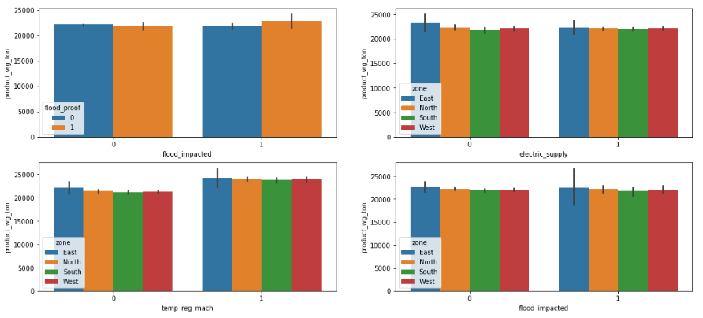
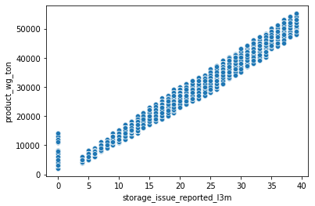
Univariate and Bivariate Analysis
Storage issues reported is in linear relationship with the weight of the product shipped.
Products are shipped in flood impacted areas despite not having flood proof.
Almost same amount of products are shipped to zones that don’t have electric backup and Temp regulator machines.
22,000 tons of product shipped in flood impacted zones across all regions.

Slide 5
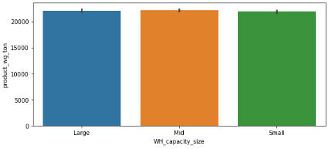
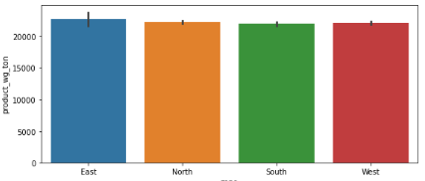
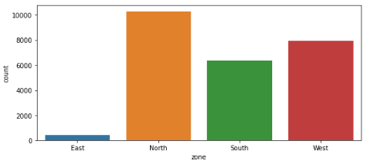
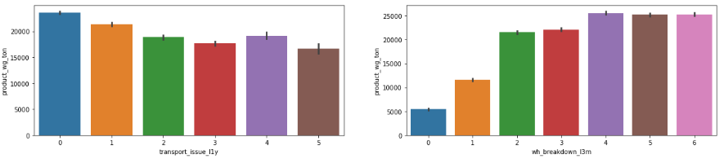
Almost same amount of products are shipped across all regions irrespective of their capacity and number of warehouses.
More than 15000 tons of products are shipped to warehouses that have reported transport issues.
Warehouses that have reported higher number of breakdowns are supplied the highest amount of products as well.

Slide 6
Modelling Approach Used – What & How?
Linear Models
Multilinear Regression - Simple & Most popular. But impacted by multicollinearity & outliers
LASSO Regression - Used when there is high multicollinearity among features. It is similar to Ridge Regression, however using a squared bias, it uses absolute value bias
Ridge Regression - Used when there is high multicollinearity among features. It adds a small squared biased factor to the variables, but reduces the variances.
Non-linear & Ensembled Models
Decision tree regression - Can be used to understand the hierarchy of features, but trees can grow very complex so require pruning and optimization. Not advised for continuous numerical outputs
Random Forest Regression - achieves extremely high accuracies, not sensitive to null values and outliers.
Gradient Boosting Regression – Better predictive accuracy, handles missing data but memory exhaustive due to hyper tuning.

Slide 7
Model | Accuracy | RMSE | MSE | MAE
Linear (Train) | 98.95 | 1189.57 | 1415077.07 | 891.87
Linear (Test) | 98.98 | 1114.22 | 1241489.22 | 850.38
Ridge (Train) | 98.96 | 1186.90 | 1408736.59 | 888.03
Ridge (Test) | 98.99 | 1111.35 | 1235103.62 | 846.98
Lasso (Train) | 98.96 | 1186.90 | 1408741.91 | 888.04
Lasso (Test) | 98.99 | 1111.35 | 1235105.07 | 846.98
Decision tree (Train) | 99.38 | 914.81 | 836890.93 | 677.59
Decision tree (Test) | 99.29 | 964.03 | 929355.99 | 723.10
Random Forest (Train) | 99.90 | 363.71 | 132291.22 | 266.09
Random Forest (Test) | 99.33 | 939.21 | 882129.50 | 704.14
Gradient boosting (Train) | 99.35 | 937.18 | 878306.96 | 695.73
Gradient boosting (Test) | 99.38 | 901.24 | 812239.52 | 686.24

Slide 8
Recommendations
From models gradient boosting being the best model, the feature importance of variables were calculated.
It is found that storage issues reported has the highest significance among all models with the predictor variable. More products should be shipped to warehouses having less storage issues which also depends on the capacity. LESS CAPACITY = MORE STORAGE ISSUES
Warehouses that have temperature regulators and less number of breakdowns should be shipped more products to avoid spoilage.
More products to be shipped to warehouses that have reported less transport issues which also has an effect on number of refills. LESS NO OF REFILL = LESS TRANSPORT ISSUES AND REDUCED TRANSPORTATION COST
Cut down labour count in small warehouses. Shortage of workers in large warehouses might lead to low maintenance or labour strike (Warehouse Breakdown)
Increase products to be shipped in rural areas as there is demand (equal no of retail shops) also keeping transport issues and other facilities in check.

Slide 9
THANK YOU

